Slide 1

ARTIFICIAL INTELLIGENCE
Week 8 — Search Strategies
Uninformed Search · Informed Search · Adversarial Search
BFS · DFS · UCS · IDS · Greedy BFS · A* · Min-Max
Lectures 15 & 16 | W8

Slide 2
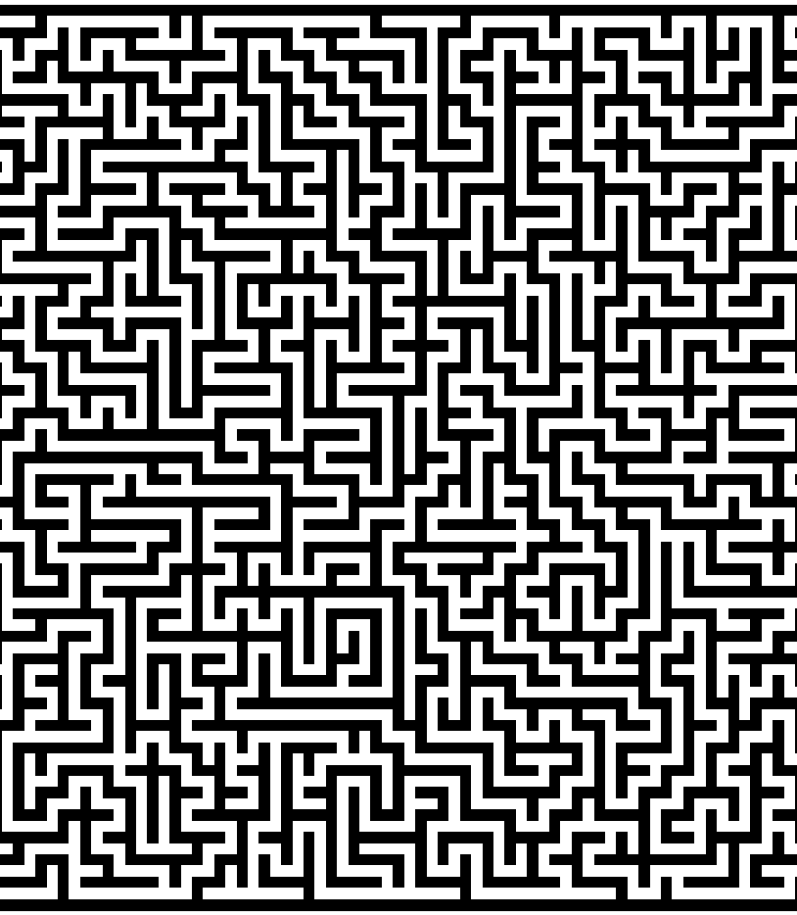
W8 | AI
CONTENTS
01
Lecture 15: Search Strategies
Choosing states and actions
Uninformed search: BFS, UCS, DFS, IDS
Informed vs. Uninformed search concepts
02
Lecture 16: Informed & Adversarial Search
Greedy Best-First Search
A* Search algorithm and heuristics
Adversarial Search & Min-Max Algorithm
02

Slide 3

01
LECTURE 15
SEARCH STRATEGIES
From problem formulation to systematic exploration
of state spaces using uninformed search methods

Slide 4
W8 | AI
Choosing States and Actions
A well-defined AI problem has five key components:
EXAMPLE
Route Finding Problem
Initial State
The starting configuration of the agent
States: Cities on the map
Actions: Driving between connected cities
Transition: Moving from one city to another
Goal Test: Reaching the destination city
Path Cost: Total distance traveled (km)
The agent's task is to find a sequence of actions (a path) that transforms the initial state into a goal state while minimizing the path cost.
Actions
Available operations at each state
Transition Model
Result of applying an action to a state
Goal Test
Determines if a goal state is reached
Path Cost
Numeric cost of each step along the path
04

Slide 5
W8 | AI
Introduction to Search Strategies
Search strategies define how an agent systematically explores the state space. Every strategy is evaluated along four key dimensions:
Completeness
Optimality
Time Complexity
Space Complexity
Guarantees finding a solution if one exists
Finds the lowest-cost solution
How long to find a solution
Memory required during search
Two Main Categories
Uninformed Search
Informed Search
Blind Search — No domain knowledge
Heuristic Search — Uses domain knowledge
• Systematically explores without problem-specific knowledge
• Treats all states equally
• Examples: BFS, DFS, UCS, IDS
• Uses heuristic functions to guide exploration
• Prioritizes promising paths toward the goal
• Examples: Greedy BFS, A*, IDA*
05

Slide 6
W8 | AI
Uninformed vs. Informed Search
Uninformed (Blind) Search
Informed (Heuristic) Search
Definition
Explores systematically without problem-specific knowledge.
Key Characteristics
• No additional information about states
• Treats all states equally
• Relies only on the problem definition
Algorithms
• BFS, DFS, UCS, IDS
Trade-off
Guaranteed completeness but potentially inefficient.
Definition
Uses domain-specific knowledge to guide exploration toward the goal.
Key Characteristics
• Uses heuristic function h(n) to estimate goal proximity
• Prioritizes promising paths
• More efficient than uninformed methods
Algorithms
• Greedy Best-First Search
• A* Search
• Iterative Deepening A* (IDA*)
Trade-off
Faster but requires a good heuristic; optimality depends on heuristic quality.
06

Slide 7
W8 | AI
Breadth-First Search (BFS)
UNINFORMED
BFS expands the shallowest node first using a FIFO queue.
BFS Tree Expansion
S
ALGORITHM
1. Initialize frontier with the start node
2. Remove the front node, check if goal
3. If not goal, add all children to the back of frontier
4. Repeat until goal found or frontier empty
A
B
Properties
C
D
E
F
Complete — finds solution if exists
■ Start Node
■ Level 1 (Expanded First)
■ Level 2 (Expanded Next)
Expansion order: S → A → B → C → D → E → F
Optimal for unweighted graphs
COMPLEXITY
Time: O(b^{d})
Space: O(b^{d})
where b = branching factor, d = depth of shallowest solution
07

Slide 8
W8 | AI
BFS — Example: Route Finding
Problem: Find a path from Arad to Bucharest in Romania. BFS explores all cities at each distance level before going deeper.
LEVEL 0
BFS Expansion Order
Arad (start)
Arad
Zerind
Sibiu
Timisoara
LEVEL 1
Zerind, Sibiu, Timisoara
LEVEL 2
How BFS Works:
• Uses a FIFO queue — first node in, first node out
• Explores all nodes at distance d before any node at distance d+1
• Guarantees the shortest path in terms of number of edges
Memory Challenge:
At depth 10 with branching factor 10, BFS needs to store 10 billion nodes — extremely memory-intensive for deep solutions.
Oradea, Fagaras, Rimnicu, Lugoj
LEVEL 3+
Continues until Bucharest reached
Result: Finds path with minimum number of steps
Limitation: May not find least-cost path when edges have different weights
08

Slide 9
W8 | AI
Uniform Cost Search (UCS)
UNINFORMED
UCS expands the lowest-cost node first. Minimizes total path cost — equivalent to Dijkstra's algorithm.
ALGORITHM
EVALUATION
1. Use a priority queue ordered by path cost g(n)
2. Always expand the least-cost node
3. If a cheaper path to a node is found, update it
4. Repeat until goal found with minimum cost
Complete: Yes (if all costs > ε)
Optimal: Yes — finds lowest-cost path
Time: O(b^(1+C*/ε))
Space: O(b^(1+C*/ε))
BFS vs. UCS
Property | BFS | UCS
Priority | Depth (shallowest first) | Path cost g(n) (cheapest first)
Optimality | Optimal for unweighted graphs | Optimal for all positive costs
Best For | Equal step costs | Varying step costs
09

Slide 10
W8 | AI
UCS — Example
Route finding with varying distances from Arad. UCS explores by cumulative cost, always expanding the cheapest path found so far.
Path | Cost (km) | Order
Arad → Zerind | 75 | 1st
Arad → Sibiu | 140 | 3rd
Arad → Timisoara | 118 | 2nd
Arad → Lugoj | 229 | 5th
Arad → Oradea | 146 | 4th
... → Bucharest | optimal | goal
KEY INSIGHT
How UCS differs from BFS:
• BFS would explore by number of hops
• UCS explores by total distance
UCS may explore a longer path (more hops) if its total cost is lower than a shorter path with expensive edges.
Trade-off: Slower step-by-step but guarantees the optimal-cost solution.
Evaluation Function: g(n) = cost of path from start to node n
UCS is a special case of A* where the heuristic h(n) = 0 for all nodes. It relies purely on the accumulated path cost without any goal-directed guidance.
10

Slide 11
W8 | AI
Depth First Search (DFS)
UNINFORMED
DFS explores as deeply as possible before backtracking using a LIFO stack.
DFS Tree Expansion
S
ALGORITHM
1. Push start node onto the stack
2. Pop the top node; if goal, return
3. Push all unvisited children onto the stack
4. Repeat until goal found or stack empty
A
B
Properties
C
D
Incomplete for infinite spaces
Not Optimal — finds deep suboptimal paths
■ Path Taken (Deep First)
■ Deferred (Backtrack Later)
Expansion order: S → A → C (deep)
Then backtracks to explore B, D
COMPLEXITY
Time: O(b^{m})
Space: O(bm)
where b = branching factor, m = maximum depth
Key advantage: Very memory-efficient compared to BFS
11

Slide 12
W8 | AI
DFS — Example & Memory Analysis
In maze-solving, DFS picks a path and follows it to the deepest level. When it hits a dead end, it backtracks to the most recent unexplored branch.
Memory Comparison: BFS vs. DFS
Depth | Nodes | BFS Memory | DFS Memory
2 | 110 | 107 KB | ~156 KB
4 | 11,110 | 10.6 MB | ~156 KB
6 | 106 | 1 GB | ~156 KB
8 | 108 | 103 GB | ~156 KB
10 | 1010 | 10 TB | ~156 KB
12 | 1012 | 1 PB | ~156 KB
16 | 1016 | 10 Exabytes | ~156 KB
KEY INSIGHT
At depth 16, BFS requires 10 exabytes of memory while DFS needs only ~156 KB — a difference of 10 trillion times!
However, DFS might find a long, winding path while a shorter path exists on another branch.
Best suited for: Memory-constrained problems with deep solutions.
Why DFS is memory-efficient: DFS only stores the current path from root to leaf plus unexplored siblings at each level. Space = O(bm) where m is maximum depth. BFS stores all nodes at the current frontier level. Space = O(b^{d}).
12

Slide 13
W8 | AI
Iterative Deepening Search (IDS)
UNINFORMED
IDS combines the best of BFS and DFS by performing repeated depth-limited searches with increasing depth limits.
ALGORITHM
EVALUATION
For limit = 0, 1, 2, ...
Perform DFS with current depth limit
If solution found, return it
Continue until solution found
Complete: Yes (like BFS)
Optimal: Yes for unweighted (like BFS)
Time: O(b^{d})
Space: O(bd) (like DFS!)
Why the Overhead is Small
Most nodes in a search tree are at the bottom level. Re-generating upper levels adds only a constant fraction to the total time. For a tree with branching factor b and solution depth d, the overhead is approximately b/(b-1), which is very small for large b.
IDS is the preferred uninformed search method when the search space is large and the solution depth is unknown. It offers the completeness of BFS with the memory efficiency of DFS.
13

Slide 14
W8 | AI
IDS — Example
IDS iteratively increases the depth limit, performing a complete DFS at each level until the goal is found.
Limit = 0
Limit = 1
Limit = 2
Limit = d (found!)
Only the root node S is explored.
If S is the goal, return it. Otherwise, increase limit.
Explore S and all nodes at depth 1 (A, B).
If goal found, return. Otherwise, increase limit.
Explore S, depth 1, and depth 2 nodes (C, D, E, F).
Continue until goal found.
Goal node found at depth d. Algorithm terminates with the optimal solution.
Overhead Analysis
Let N(IDS) = total nodes generated by IDS, N(BFS) = total nodes generated by BFS. For branching factor b, the ratio is:
N(IDS) / N(BFS) = b / (b - 1)
For b = 10, the overhead is only 10/9 ≈ 11% — a small price for massive memory savings.
Summary: IDS = BFS's completeness + optimality + DFS's memory efficiency. Preferred when space is limited.
14

Slide 15

02
LECTURE 16
INFORMED & ADVERSARIAL SEARCH
Using heuristics and game theory to make
intelligent decisions in competitive environments

Slide 16
W8 | AI
Greedy Best-First Search
INFORMED
Greedy BFS expands the node that appears closest to the goal according to a heuristic function h(n). It prioritizes speed over optimality.
Evaluation Function: f(n) = h(n)
ALGORITHM
LIMITATIONS
1. Evaluate h(n) for each node
2. Expand the node with lowest h(n)
3. Repeat until goal reached
Not Complete — can get stuck in loops
Not Optimal — follows locally promising paths
Time/Space: O(b^{m}) in worst case
The Heuristic Function h(n)
The heuristic h(n) estimates the cost from node n to the goal. Common heuristics include:
• Straight-line distance (SLD) — Euclidean distance on maps (always admissible)
• Manhattan distance — Sum of horizontal/vertical distances (for grid worlds)
• Misplaced tiles — Count of tiles in wrong position (for 8-puzzle)
16

Slide 17
W8 | AI
Greedy BFS — Example
Problem: Find path from Arad to Bucharest using Straight-Line Distance (SLD) heuristic.
Heuristic Values (SLD to Bucharest)
Path Taken by Greedy BFS
City | h(n) = SLD | Chosen?
Arad | 366 | Start
Zerind | 374 | No
Sibiu | 253 | Yes
Timisoara | 329 | No
Arad (h=366) → neighbors: Zerind(374), Sibiu(253), Timisoara(329)
Sibiu (h=253) → chooses Fagaras(176)
Fagaras (h=176) → reaches Bucharest(0)
Path cost: 140 + 99 + 211 = 450 km
The Problem: Not Optimal!
The optimal path via Rimnicu Vilcea → Pitesti → Bucharest costs only 418 km, but Greedy BFS never explores it because Rimnicu Vilcea (h=193) looks worse than Fagaras (h=176) from Sibiu.
Greedy BFS sacrifices optimality by only considering the estimated remaining cost, ignoring the cost already spent.
17

Slide 18
W8 | AI
A* Search Algorithm
INFORMED
A* combines actual path cost g(n) with heuristic estimate h(n). It is the most widely used search algorithm in AI.
f(n) = g(n) + h(n) where g(n) = path cost, h(n) = heuristic estimate
ALGORITHM
PROPERTIES
1. Initialize OPEN with start node
2. Remove node with lowest f(n) from OPEN
3. If goal, return solution path
4. Generate successors, compute f(n)
5. Add to OPEN; track best path to each node
6. Repeat until OPEN empty or goal found
Complete: Yes (guaranteed solution)
Optimal: Yes if h(n) is admissible
Time: Depends on heuristic quality
Space: O(b^{d}) — keeps all nodes
The gold standard of search algorithms
The Balance: Greedy vs. UCS
• When h(n) = 0, A* becomes UCS (explores by cost only, guaranteed optimal but slow)
• When g(n) = 0, A* becomes Greedy BFS (explores by heuristic only, fast but not optimal)
• A* with a good heuristic achieves both efficiency and optimality
18

Slide 19
W8 | AI
A* — Example: The 8-Puzzle
The 8-puzzle demonstrates how heuristic quality dramatically affects A* performance. Two common heuristics:
h₁(n) = Misplaced Tiles
h₂(n) = Manhattan Distance
Count tiles not in their goal position.
Simple but weak heuristic — ignores how far tiles must move.
Sum of horizontal + vertical distances of each tile from its goal.
Stronger heuristic — more informed, reduces search space significantly.
Performance Comparison
Depth | IDS (nodes) | A* (h₁) | A* (h₂)
2 | 10 | 6 | 6
8 | 6,384 | 39 | 25
14 | 3,473,941 | 539 | 113
20 | — | 7,276 | 676
24 | — | 39,135 | 1,641
KEY INSIGHT
At depth 14, A* with h₂ expands 113 nodes vs. 539 nodes with h₁ — a 5x improvement!
Better heuristics dramatically reduce the search space. A* expands nodes in order of increasing f-value, gradually adding "f-contours."
19

Slide 20
W8 | AI
A* Heuristics: Admissibility & Consistency
The quality of A* depends entirely on the heuristic. Two critical properties ensure optimality:
Admissibility
Consistency (Monotonicity)
0 ≤ h(n) ≤ h*(n)
h(n) ≤ c(n,n') + h(n')
A heuristic never overestimates the true cost to the goal. It is optimistic.
Example: Straight-line distance on a map is always admissible — the shortest path between two points is a straight line.
If h(n) is admissible, A* is optimal (tree search).
The heuristic satisfies the triangle inequality — estimates don't jump around.
A consistent heuristic is also admissible. When h is consistent, A* never re-opens closed nodes.
If h(n) is consistent, A* is optimal (graph search).
Generating Heuristics: Relaxed Problems
A powerful technique: solve a relaxed (simpler) version of the problem. The optimal cost of the relaxed problem is an admissible heuristic for the original.
• 8-puzzle relaxed: tiles can move anywhere → h₁ (misplaced tiles)
• 8-puzzle relaxed: tiles can slide to any adjacent square → h₂ (Manhattan distance)
20

Slide 21
W8 | AI
Introduction to Adversarial Search
Adversarial search deals with competitive multi-agent environments where agents have conflicting goals. The most common application is game playing.
Key Characteristics
Two Players
Perfect Information
Zero-Sum Game
MAX and MIN alternate turns, each trying to maximize their own outcome
Both players know the complete game state at all times
One player's gain is the other's loss; total utility is constant
Applications
Adversarial search powers AI game players in: Chess (Deep Blue, Stockfish), Checkers (Chinook), Go (AlphaGo), Tic-Tac-Toe, and Othello/Reversi. The goal is to find the optimal strategy assuming the opponent also plays optimally — this is the foundation of game theory.
Core Question: What move should MAX make, assuming MIN will respond with the best possible counter-move?
21

Slide 22
W8 | AI
The Min-Max Algorithm
Minimax is a recursive backtracking algorithm for optimal decision-making in two-player games. MAX aims to maximize utility; MIN aims to minimize it.
ALGORITHM
1. Generate the complete game tree to a specified depth limit
2. Assign utility values to leaf nodes using an evaluation function
3. Backtrack: At MAX nodes, take the maximum of children's values
4. At MIN nodes, take the minimum of children's values
5. The backed-up value at the root determines MAX's optimal move
Core Concept
MAX Player
MIN Player
Selects the move with the MAXIMUM utility value. Tries to maximize the score.
Selects the move with the MINIMUM utility value. Tries to minimize MAX's score.
Key Assumption: Both players play optimally. Minimax finds the best guaranteed outcome for MAX, assuming MIN never makes a mistake. Uses depth-first search to explore the game tree.
22

Slide 23
W8 | AI
Min-Max — Example
Consider a game tree where leaf nodes have the following utility values:
Game Tree
Step-by-Step Calculation
A (MAX)
Step 1: Evaluate leaf nodes (given)
D=3, E=5, F=6, G=9, H=1, I=2
Step 2: At B (MIN): min(3, 5, 6) = 3
At C (MIN): min(9, 1, 2) = 1
Step 3: At A (MAX): max(3, 1) = 3
Result: Optimal value = 3, choose move B
B (MIN)
C (MIN)
3
5
6
9
1
2
ANALYSIS
Minimax performs a depth-first exploration of the game tree. The time complexity is O(b^{m}) and space complexity is O(bm), where b is the branching factor and m is the maximum depth. For chess (b≈35, m≈100), this is computationally infeasible without optimization.
23

Slide 24
W8 | AI
Alpha-Beta Pruning
Alpha-Beta pruning optimizes Minimax by eliminating branches that cannot affect the final decision. The result remains optimal.
Two Key Parameters
Alpha (α)
Beta (β)
The best value MAX can guarantee so far. Initialized to -∞. Updated at MAX nodes.
The best value MIN can guarantee so far. Initialized to +∞. Updated at MIN nodes.
Pruning Condition: If α ≥ β, stop exploring that branch!
Benefits & Properties
• Result unchanged — still optimal
• With perfect ordering: O(b^{m/2})
• Effectively doubles searchable depth
• Killer move heuristic: try best moves first
Chess Example:
Without pruning: branching ≈ 35
With perfect pruning: branching ≈ 6
Can search ~2x deeper in same time
24

Slide 25
W8 | AI
Search Algorithms Comparison
Algorithm | Complete | Optimal | Time Complexity | Space Complexity
BFS | Yes | Unweighted | O(b^d) | O(b^d)
UCS | Yes | Yes | O(b^(1+C*/ε)) | O(b^(1+C*/ε))
DFS | No* | No | O(b^m) | O(bm)
IDS | Yes | Unweighted | O(b^d) | O(bd)
Greedy BFS | No | No | O(b^m) | O(b^m)
A* | Yes | Yes** | Depends on h | O(b^d)
Minimax | With limit | Yes | O(b^m) | O(bm)
*Complete for finite spaces **Optimal if h(n) is admissible
25

Slide 26
W8 | AI
Key Takeaways
1
Problem formulation (states, actions, goal test, path cost) is the foundation of all search methods. Well-defined problems lead to efficient solutions.
2
Uninformed search (BFS, DFS, UCS, IDS) guarantees solutions without domain knowledge. IDS offers the best balance of completeness and memory efficiency.
3
Informed search (Greedy BFS, A*) uses heuristics to dramatically improve efficiency. A* is optimal with admissible heuristics — the gold standard.
4
Adversarial search (Minimax, Alpha-Beta) handles competitive multi-agent scenarios. Alpha-Beta pruning doubles the searchable depth without changing the result.
5
Strategy selection depends on problem characteristics: completeness requirements, optimality needs, and resource constraints.
26

Slide 27

THANK YOU
Artificial Intelligence — Week 8
"The question of whether a computer can think is no more interesting
than the question of whether a submarine can swim."
— Edsger Dijkstra
Lectures 15 & 16 | Search Strategies

